Slide 1
DETECTING THE MOVEMENT OF OBJECTS WITH WEBCAM
PRESENTED BY : PROJECT GUIDE :
TANGELLAMUDI SAI TEJA : [19E31A1226] Mr. R. KESAVAIAH SAIRI LAXMI PRASANNA : [19E31A1221] Assistant Professor
LINGALA NAVEEN : [20E35A0507]

Slide 2
INDEX
ABSTRACT
INTRODUCTION
EXISTING SYSTEM
PROPOSED SYSTEM
SYSTEM ARCHITECTURE
SYSTEM REQUIREMENTS
UML DIAGRAMS
IMPLEMENTATION
OUTPUT SCREENS
CONCLUSION
FUTURE SCOPE
APPLICATIONS

Slide 3
ABSTRACT
In this Project ,Proposes A Method For Detecting The Motion in a Particular Region Being Observed.
The Motion Tracking Surveillance Has Gained A Lot Of Interests Over Past Few Years.
This System Is Brought Into Effect Providing Relief To The Normal Video Surveillance System Which Offers Time-Consuming Reviewing Process.
Through The Study And Evaluation Of Products, We Propose A Motion Tracking System Consisting Of Its Method For Motion Detection .
In Our Proposed System Those Disadvantages Are Omitted And Combining The Usage Of Best Method We Are Creating A New Motion Detection Algorithm For Our Proposed Motion Tracking System.

Slide 4
INTRODUCTION
Motion detection is the process of detecting a change in the position of an object relative to its surroundings or a change in the surroundings relative to an object.
Motion detection can be achieved by either mechanical or electronic methods. When motion detection is accomplished by natural organisms, it is called motion perception.
A motion detector is a device that detects moving objects, particularly people.
Such a device is often integrated as a component of a system that automatically performs a task or alerts a user of motion in an area.
The process of video compression using motion estimation is also known as interframe coding.

Slide 5
EXISTING SYSTEM
Digital surveillance systems are mostly specifically designed for commercial use, and it has always been out of reach for other users.
The cost for CCD cameras, networking devices and the software designed for this system has made it inaccessible and impractical for home users with moderate requirements. Also, not all the existing products have the motion detection function.
In traditional systems for security operations, cameras are used to deliver analogue video images to monitors or time-lapse video cassette recorders (VCR).
Although many local image processing functions are possible to improve the system application, this requires a lot of processing resources and high-power-consuming hardware.
Although Digital video surveillance and security systems are widely used, analogue systems still serve as a cheaper alternative.

Slide 6
DISADVANTAGES
Used for Commercial purposes.
Inaccessible to the other users(common people).
CCD cameras, networking devices are Expensive.
Absence of motion detection functionality.
Requires a lot of processing resources.
Archive space used to store videos is too high.
Manual monitoring of videos is Time consuming.
Requires high-power-consuming hardware
Less accuracy
low Efficiency

Slide 7
PROPOSED SYSTEM
In this we are going to write a python program which is going to analyze the images taken from the webcam and try to detect the movement.
Videos can be treated as a stack of pictures called frames. Here I am comparing different frames(pictures) to the first frame which should be static(No movements initially).
We compare two images by comparing the intensity value of each pixel.
In my project, we used Python Programming Language and its most important and specific libraries OpenCV which is most required for solving problems related to images and videos and this is an Open-Source Computer Vision based personal project to detect Human Faces and different objects coming in front of the webcam for a specific time frame.
This python scripts detects movement on your web-cam and outlines the moving object on your computer screen.

Slide 8
ADVANTAGES
Requires less memory.
Analysis is done automatically.
Alert systems may be implemented automatically when the motion is detected.
High accuracy
High efficiency

Slide 9

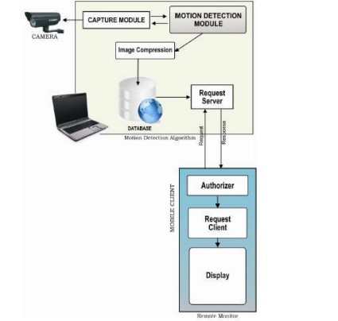
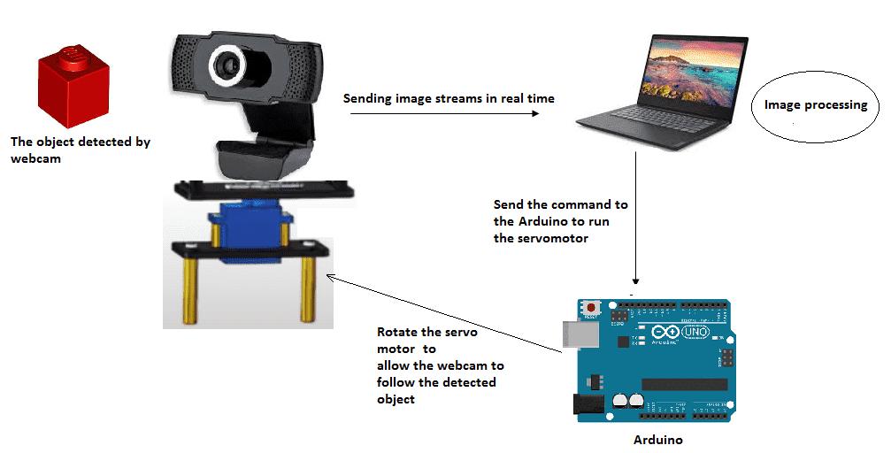



SYSTEM ARCHITECTURE

Slide 10
SYSTEM REQUIREMENTS
HARDWARE REQUIREMENTS:
System : MINIMUM i3.
Hard Disk : 40 GB.
RAM : 4 GB.
SOFTWARE REQUIREMENTS:
Operating System : Windows 8,10 & 11
Coding Language : Python 3.7

Slide 11
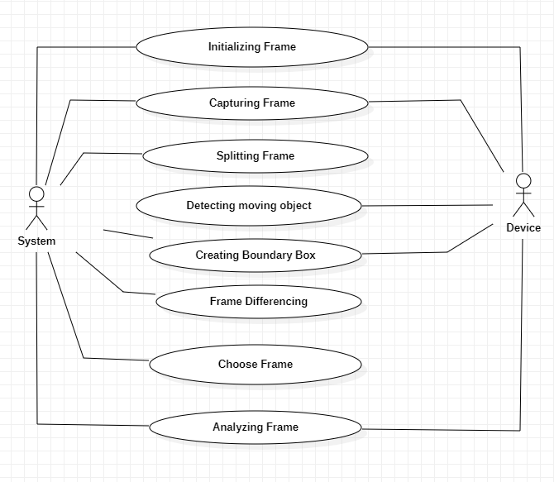
UML DIAGRAMS USE-CASE DIAGRAM
These diagrams also identify the interactions between the system and actions.

Slide 12
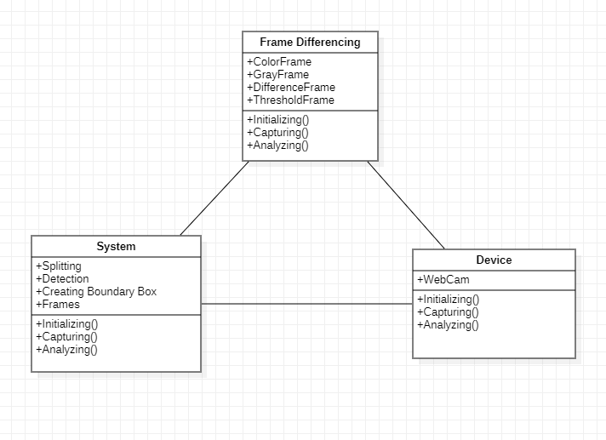
CLASS DIAGRAM
Class Diagram is the main building block of object-oriented modelling.
A class consists of its objects, and it may inherit from other classes.

Slide 13
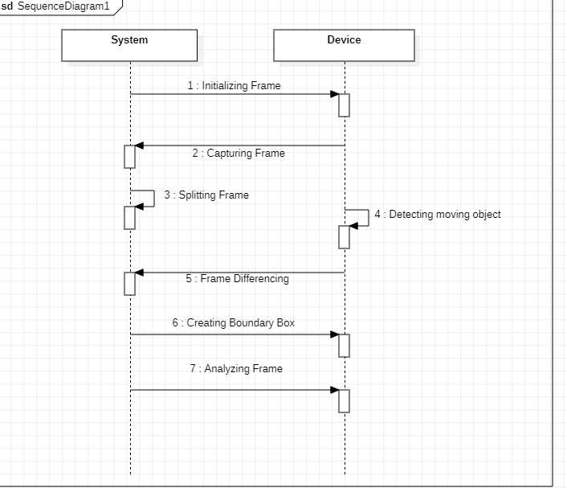
SEQUENCE DIAGRAM
It represents the object participating the interaction horizontally and time vertically.
Message flow is represented by vertical doted lines.

Slide 14
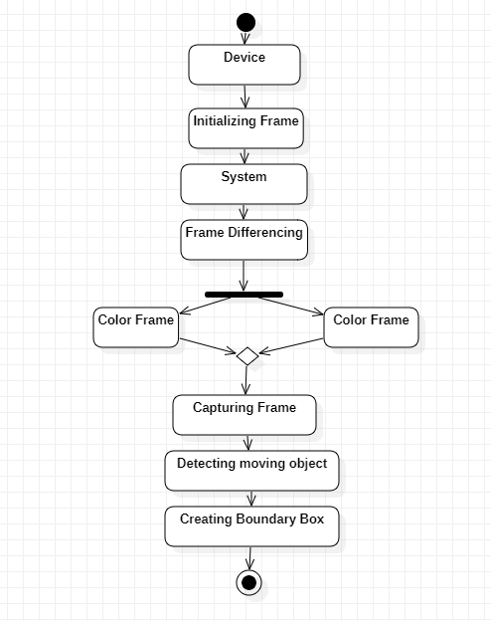
ACTIVITY DIAGRAM
Activity diagram are representation of workflows of stepwise activities and actions with support for choice, iteration and concurrency.

Slide 15
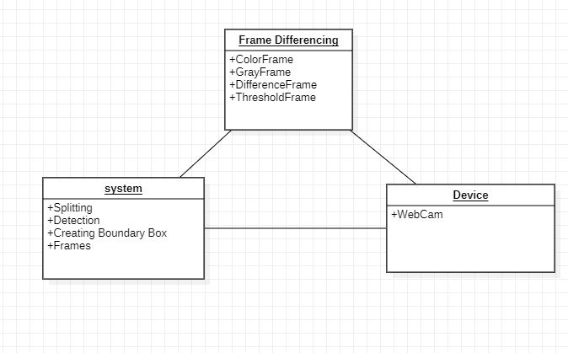
OBJECT DIAGRAM
Object diagram use notation that is similar to that used in class diagram.
Objects help in portraying a static view of an object – oriented system at a specific instant.

Slide 16
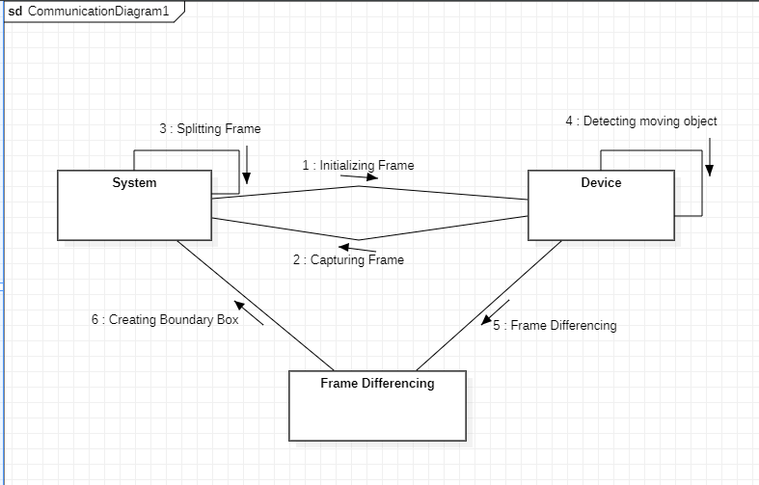
COLLABORATION DIAGRAM
It describes the relationships and interactions among software objects in the UML
These diagrams can be used to portray the dynamic behaviour of a particular use case and define the role of each object.

Slide 17
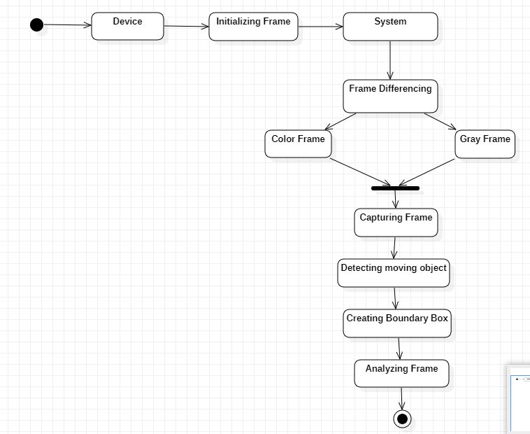
STATE CHART DIAGRAM
State chart describe a state machine. States are controlled by the internal or external events.
State chart diagram describes the flow of control from one state to another state.

Slide 18
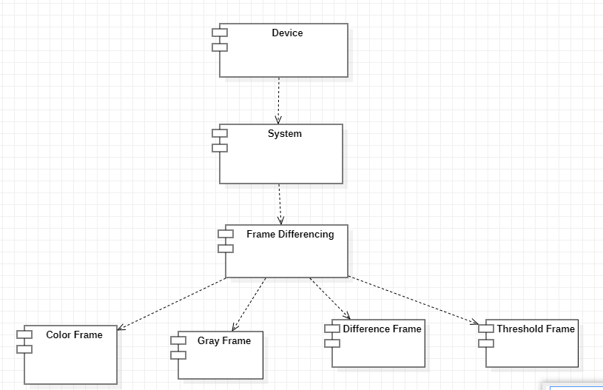
COMPONENT DIAGRAM
Component diagram is used to break down a large object-oriented system into the smaller components.
It visualizes the relationships as well as the organization between the components present in the system.

Slide 19
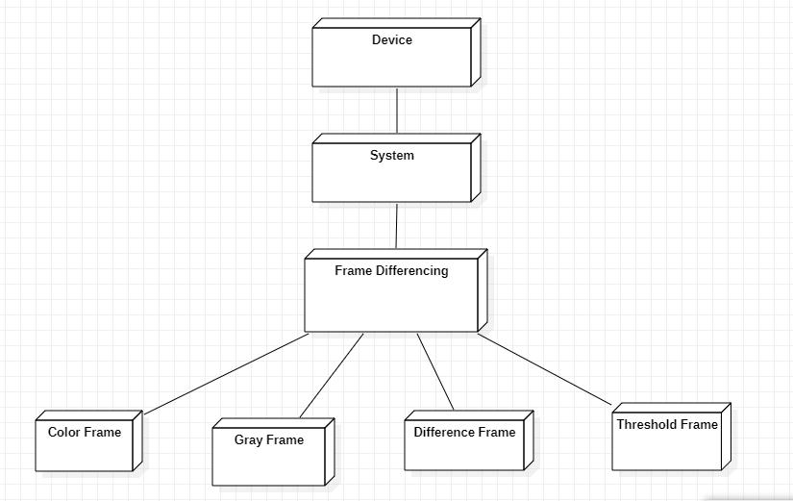
DEPLOYMENT DIAGRAM
Deployment diagram are typically used to visualize the physical hardware and software of a system.
It involves the nodes and their relationships.

Slide 20
IMPLEMENTATION
DETECTING MOVEMENT OF OBJECTS:
Detecting movement of objects with a webcam refers to the process of analyzing the video stream captured by a webcam to identify regions or objects that are undergoing motion.
It involves comparing consecutive frames and detecting changes in pixel values, patterns, or optical flow to determine the presence and location of moving objects within the scene.
Various techniques can be employed for motion detection, including frame differencing, background subtraction, and optical flow analysis.
These methods utilize algorithms and image processing techniques to highlight regions where motion occurs, typically by generating a binary mask or highlighting the moving areas within the video frames.

Slide 21
MOTION TRACKING SYSTEM:
A motion tracking system is a technology that detects and tracks the movement of objects or individuals in each environment.
It is widely used in various fields, including computer vision, robotics, surveillance, sports analysis, and virtual reality.
By analyzing the changes in position, shape, or appearance of objects over time, motion tracking systems provide valuable information about motion patterns, interactions, and behavior.
The primary goal of a motion tracking system is to track the movement of objects accurately and efficiently in real-time.
This is typically achieved by utilizing cameras or other sensing devices to capture visual information or other relevant data.

Slide 22
FRAME DIFFERENCING:
This method involves calculating the pixel-wise absolute difference between consecutive frames.
The resulting difference image highlights areas with significant changes in pixel values, indicating motion.
By applying thresholding and morphological operations, you can identify and extract moving objects.
However, this method is sensitive to changes in lighting conditions and can produce false positives due to noise or small variations.

Slide 23
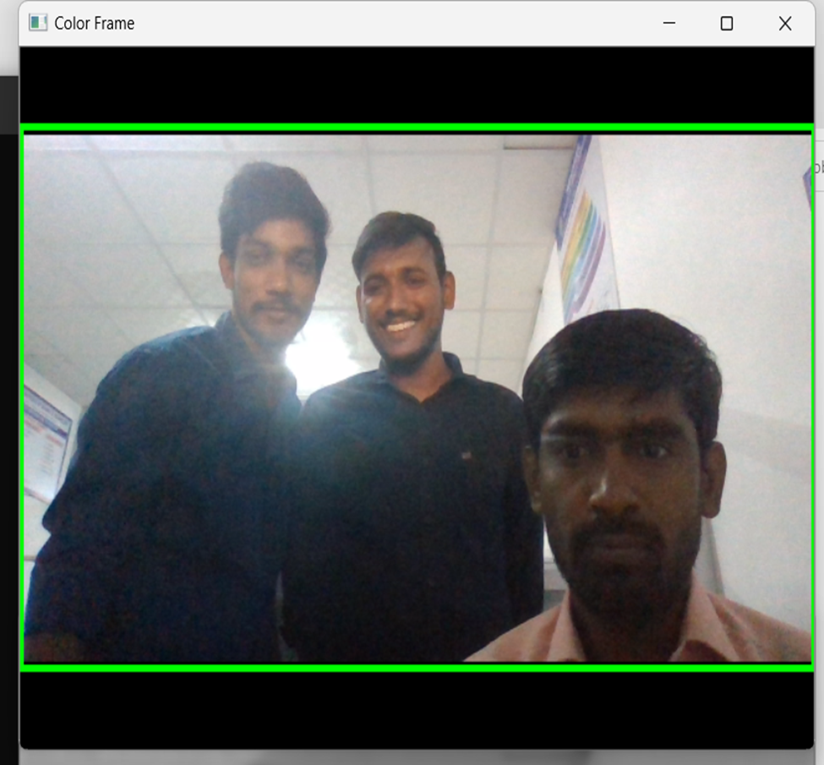
OUTPUT SCREENS
COLOR FRAME:
In this frame, you can see the color images in color frame along with green contour around the moving objects .

Slide 24
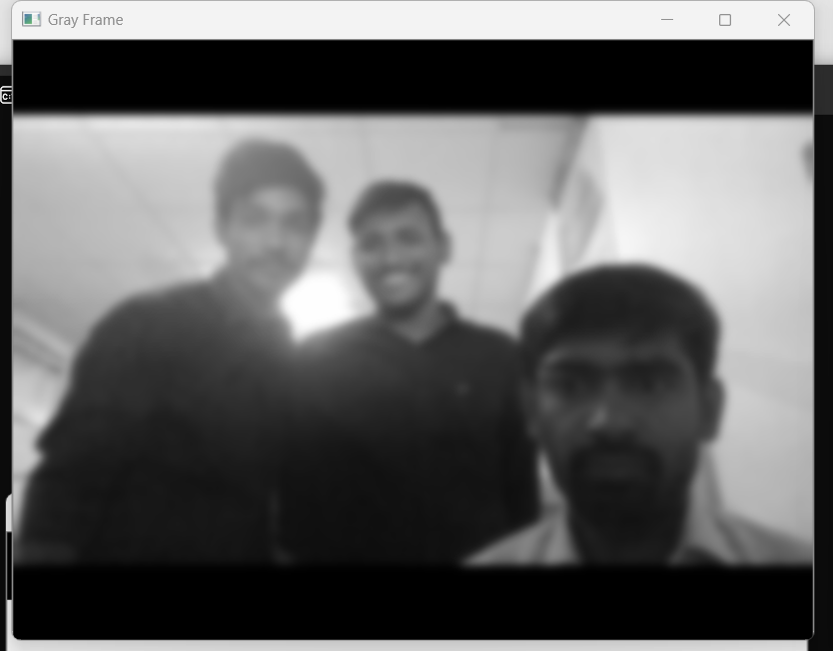
GRAY FRAME:
In Gray frame the image is a bit blur and in grayscale we did so because, In gray pictures there is only one intensity value whereas in RGB (Red, Green and Blue) image there are three intensity values. So, it would be easy to calculate the intensity difference in grayscale.

Slide 25
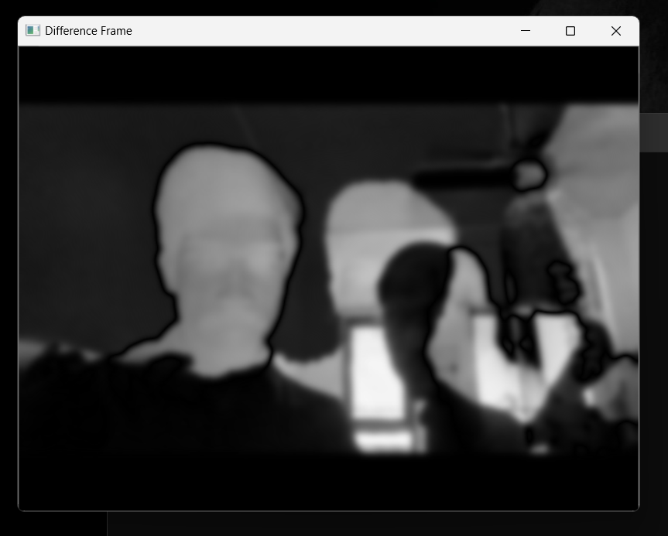
DIFFERENCE FRAME:
Difference frame shows the difference of intensities of first frame to the current frame.

Slide 26
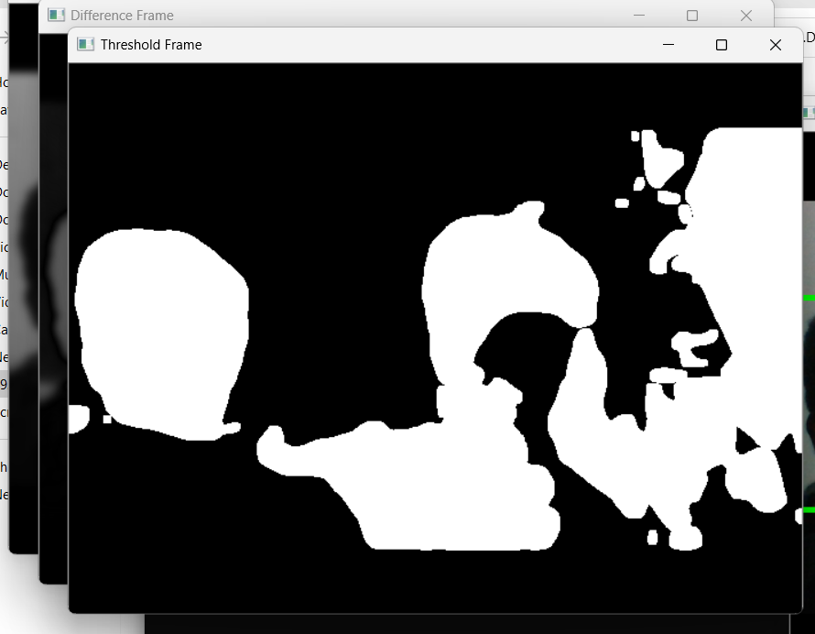
THRESHOLD FRAME:
If the intensity difference for a particular pixel is more than 30(in my case) then that pixel will be white and if the difference is less than 30 that pixel will be black.

Slide 27
CONCLUSION
Although we have many motion detection algorithms previously implemented, the current algorithm implemented is much more efficient than that of before.
It just takes the input frame of images and detects the difference considering it as the motion detection.
Alert systems may be implemented automatically when the motion is detected.
The outcome of the project is to detect motion through a webcam with much higher accuracy than any other previously implemented motion detection algorithms.

Slide 28
FUTURE SCOPE
We all can see that now we can perform multiple actions sitting at our home for which we had to run around many offices back then. Some of these tasks were performed using a webcam, like for the purpose of official documents, for online exams, for online proctoring, and many other tasks. Now, every laptop comes embedded with a camera; thus, giving us the option to perform all these tasks from sitting at our home. This feature enabled us to perform all these tasks without any hustle and without worrying about running from here to there. Apart from these benefits, the webcam feature also provides us the convenience of sitting at home and saves our time.

Slide 29
APPLICATIONS
Surveillance and Security
Robotics and Automation
Sports Analysis and Training
Human-Computer Interaction
Medical and Rehabilitation
Film and Animation
Biomechanics and Ergonomics
Automotive and Driver Assistance
Virtual Reality and Augmented Reality

Slide 30
THANK YOU

